Slide 1

Sustaining the Profession: Trends, Demand, and Mentorship for the Academic Library Job Search
Max Eckard
Assistant Archivist for Digital Curation
Bentley Historical Library
University of Michigan
Notes:
Jason McHuff
MAX Light Rail Train
https://www.flickr.com/photos/jmchuff/2841508495/in/photolist-5k6ttM-6hQcmH-6hQck2-6hQchK-6hUkbQ-6hUkdY-6hQcix-6hUkth-6hUkry-6hUkuY-6hUkdu-6hUkpY-6hQc9n-6hQco8-6hUkcE-6hUkd7-5mTdCQ-8MxHa-5iKLC3-5iFsf8-3dgu6E-dysUY9-dyQY94-5p4rmk-a8P47u-5TaB7-CjpbT-dtWpwK-5iFsS2-4tsgMt-8LLAj5-Cjstj-5iKK8q-4SM1zP-4vAMiG-64A6ew-4waW4r-dysV5q-5oTW5y-5oTW6J-4waQik-64A5dq-64vPJT-4RjSo3-5kaKhE-61Bm7z-4SNkR9-64vVBr-64vWJZ-5k6sVH
Dr. Yoo asked me to talk a bit about a recent presentation I was part of at ACRL in Portland. This image is of the MAX Light Rail, which is appropriate because the theme of the conference was sustainability (hence the title).

Slide 2
Outline
Me
Our research
Introduction
Methodology
Results (wanted an academic library job)
Discussion (wanted one and got it)
Conclusion
Notes:
Myself
Research, which is what we were discussing at ACRL and which is published in the Journal of Academic Librarianship: Factors that Increase the Probability of a Successful Academic Library Job Search (pretty easy to guess what it’s about)
Hope to leave plenty of time for questions at the end.

Slide 3
Me

Slide 4
Me!
Education
UNC Chapel Hill
NCCU
Experience
Grand Valley State University
Bentley Historical Library, University of Michigan
Notes:
UNC Chapel Hill (2008)
BA
History and International Studies
Worked for a couple of years…
NCCU (2012)
MLS
Academic and Digital Librarianship (Dr. Yoo was my advisor!)
Along the way I got some experience at:
NCCU (SLIS Library)
Duke University
State Library of NC
U.S. Mission to the United Nations
UNC Health Sciences Library
Friends of the Chapel Hill Public Library
First “real” jobs at GVSU and UM, which…

Slide 5
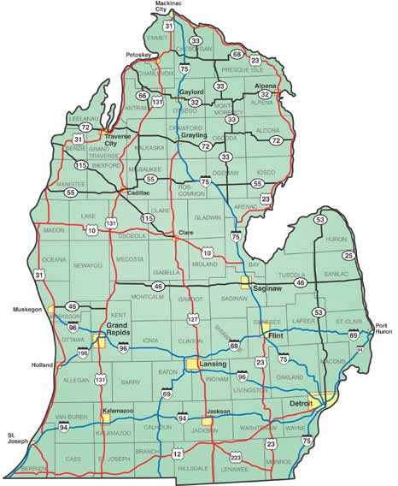
Notes:
For those of you unfamiliar with MI, here it is.

Slide 6

Notes:
GVSU
Grand Valley State University is a public liberal arts university located in Allendale, Michigan, United States.
Approximately 25,000 students.
The university was established in 1960, and its main campus is approximately 12 miles west of Grand Rapids.

Slide 7

Notes:
University Libraries
Metadata Digital Curation Librarian
Provides leadership and guidance in the development and implementation of data management strategies that will support discovery, access, management, and preservation of the University’s digital assets and resources; and assesses user needs in order to develop appropriate descriptive, structural and administrative metadata schemes for complex heterogeneous collections

Slide 8

Notes:
University of MI
The University of Michigan is a public research university located in Ann Arbor, Michigan, United States. Approximately 45,000 students.
Bentley Historical Library
The Bentley Historical Library serves as the official archives of the University of Michigan and documents the state of Michigan, its people, and organizations.
Assistant Archivist for Digital Curation

Slide 9
Our Research

Slide 10
Our Research
Introduction
Results
Methodology
Discussion

Slide 11
Our Research
Introduction
Results
Methodology
Discussion

Slide 12

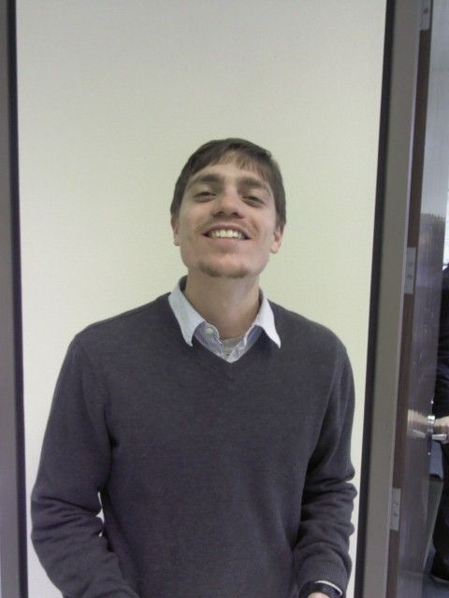
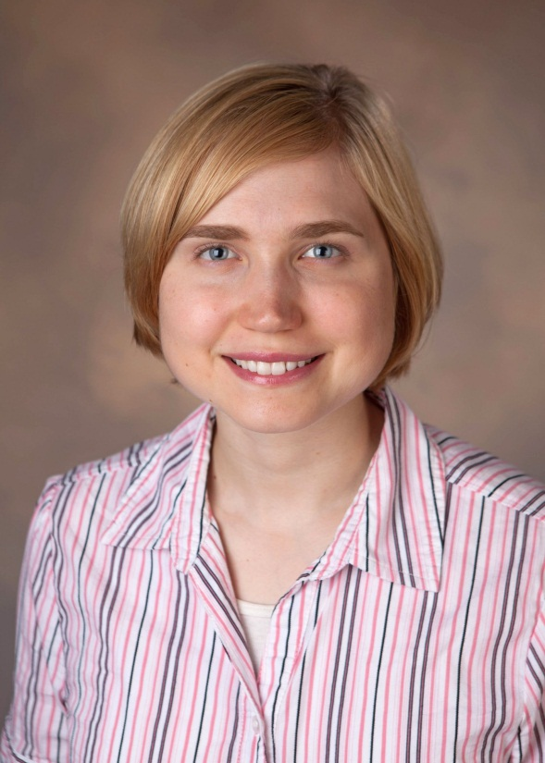
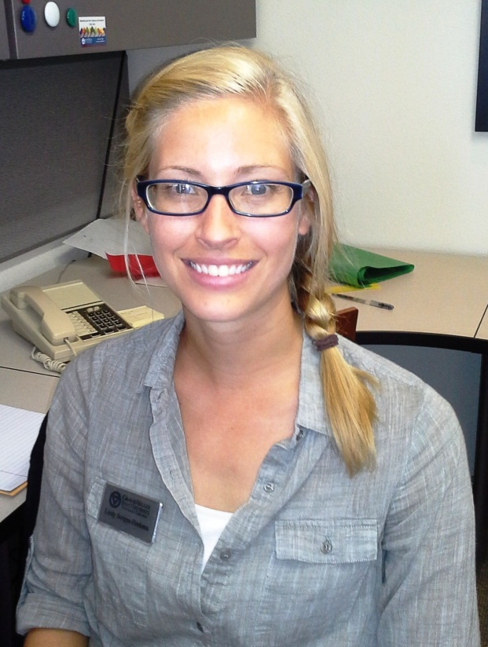
Notes:
Lindy, Ashley and I all hired at GVSU within a couple months of one another.
We were like you, very worried about finding a job. When we did, and when we looked at our backgrounds (educational, work, &c.) they were similar in some respects, but actually pretty varied.
MAX:
Unrelated job experience
Academic library internships
Middle (low) of the road library school rank
Training in digital librarianship
Not limited geographically
Likes the feel of books
Tech Service job
LINDY:
Previous career in education
Academic library employment
Internship with database vendor
Middle-of-the-road library school rank
Limited geographically
Likes reading, sometimes wears a bun
Liaison job
ASHLEY: Academic library employment AND internship
Public library practicum
Top rated library school
Undergraduate archives/library experiences
Not limited
Likes the smell of old books
Likes “getting lost in the stacks”
Liaison job
Bottom line:
We all had done a number of different things. We wondered if or why these made a difference.
LIS students have limited time to participate in extra activities.
Which experiences had the most impact?

Slide 13
Our Research
Introduction
Results
Methodology
Discussion

Slide 14
Our Research
Introduction
Results
Methodology
Discussion

Slide 15
Survey Methodology
Recent LIS Graduates
240
167
85
Institutions
33
Mean Graduation Year
2011
among them…
North Carolina Central University
Dominican University
University of Illinois at Urbana-Champaign
Notes:
Methodology:
Survey distributed in 2013
Got responses from 240. 167 wanted an academic library job. 85 wanted one and got it.
Targeted NCCU, and DU and UIUC
But also: NMRT listserv, posting it on the ACRL New Member Discussion board, and passing out links at the 2013 ACRL Conference, which allowed for gathering responses from graduates from 33 other LIS schools
Mean graduation date was 2011

Slide 16
Questions
Professional effectiveness/development
Technological competency
Scholarship
Service
Previous career(s)
Other work/life experiences
Job search
Notes:
Also on the job search, not just whether it was successful or not, you know, how many applications, when did you start applying, how many interview rounds did you make it through, etc.

Slide 17
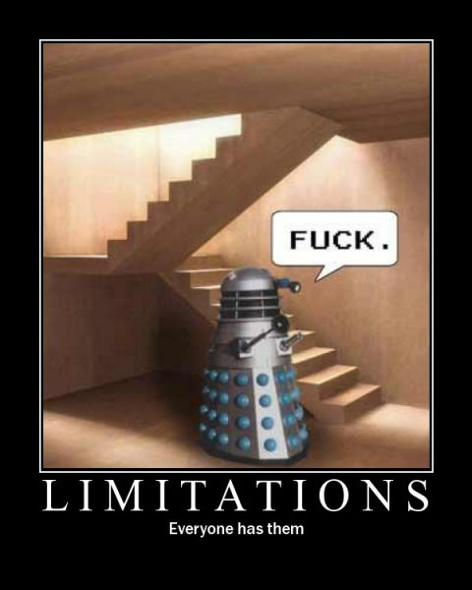
Limitations
Limited sample size
Unable to calculate a response rate
Survey questions were optional
uh oh…
Notes:
Limited sample size
Unable to calculate a response rate, since we didn’t systematically sample all LIS graduates
Optional—actually pretty standard, but it meant that people could leave early, etc.

Slide 18
Our Research
Introduction
Results
Methodology
Discussion

Slide 19
Our Research
Introduction
Results
Methodology
Discussion

Slide 20
167
out of 240
Notes:
Just a reminder, for this section, I’m talking about the results of the 167 out of 240 total participants who wanted to get an academic librarian job, but may or may not have actually received an academic library job.

Slide 21
Questions
Professional effectiveness/development
Technological competency
Scholarship
Service
Previous career(s)
Other work/life experiences
Job search
Notes:
About to go through some of the findings that stood out the most.

Slide 22
Professional Effectiveness Academic Library Coursework
88.1%

Slide 23
Professional Effectiveness Academic Library Employment
69.7%
Notes:
HAD BEEN previous employed in an academic library in some way, including as staff or paraprofessionals

Slide 24
Professional Effectiveness Academic Library Internship/Practicum
56.8%

Slide 25
Professional Development Workshops and Seminars
72.6%
Notes:
We also asked folks what sort of professional development type opportunities they had taken advantage of while in school.
Choices were:
Conference attendance, Workshops and seminars, Independent study, Publications, Conference participation, Grant writing and Additional degrees
Out of those choices, the most significant response was 72.6%. There are folks that had attended workshops and seminars.

Slide 26
Technological Competency “Competent” or “Very Competent”
71%
Notes:
This was sort of a hard question to ask, since people can mean so many different things when they talk about technology. We decided in the end to just have people self-identify whether they were Very Competent, Competent, Somewhat Competent, or Not Very Competent. So yes, we realize this isn’t hard science.
Interestingly, 71% of respondents rated themselves as being either “Competent” or “Very Competent” with regard to technological competency.

Slide 27
Scholarship Publications
9%

Slide 28
Service Join Associations
88.3%
Notes:
Specifically, we gave them the following choices:
Join associations, Student groups, Committee work, Volunteer, Fundraising
Of those, 81.3% had joined associations, which was the most significant response.

Slide 29
Previous Career(s) Librarianship as Second Career
51.9%
Notes:
We also asked people whether or not librarianship was their first CAREER. We hoped by using the word career we could distinguish between those recent graduates who had previously worked in a different profession and those that simply had a different job.
A lot of education backgrounds
Some library staff/paraprofessional backgrounds
And others with more diverse backgrounds, like law, technology, publishing, management and music.

Slide 30
Previous Career(s) 3-5 Years in Previous Career
38.9%
Notes:
We asked them how many years they had worked in their previous career, to get a sense of how far into their life’s trajectory they had gone before switching.
Our choices were:
1-2, 3-5, 6-10, 11-20, Greater than 20
Most significantly, 38.9% had worked in their career for 3-5 years before switching.

Slide 31
Previous Career(s) Helpful Previous Careers
62.1%
Notes:
Finally, we asked whether they felt that their previous career(s) helped them land a library job?
62.1% said yes, it did. Which is interesting, considering the diverse backgrounds of some of the candidates.

Slide 32
Other Work/Life Experiences Volunteer Work
61.5%
Notes:
We didn’t limit our answer choices to experiences related specifically to academic libraries, but instead asked about libraries in general.
61.5% had done volunteer work in some library (academic, public, special, &c.) to gain professional experience.

Slide 33
Other Work/Life Experiences Study Abroad
4.5%
Notes:
This is a number I’m a little disappointed in, as I personally hoped it would be higher, but just 4.5% had done some sort of study abroad experience.

Slide 34
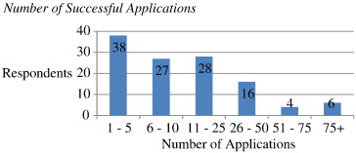
Job Search Number of Successful Applications

Slide 35
Job Search Number of Successful Applications

Slide 36
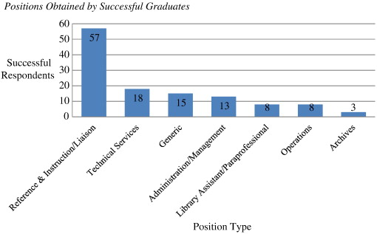
Job Search Positions Obtained…

Slide 37
Job Search Positions Obtained…

Slide 38
Our Research
Introduction
Results
Methodology
Discussion

Slide 39
Our Research
Introduction
Results
Methodology
Discussion

Slide 40
85
out of 167
Notes:
Wanted an academic library job and got it.

Slide 41
Questions
Professional effectiveness/development
Technological competency
Scholarship
Service
Previous career(s)
Other work/life experiences
Job search
Notes:
About to go through some of the findings that stood out the most.

Slide 42
Questions
Professional effectiveness/development
Technological competency
Scholarship
Service
Previous career(s)
Other work/life experiences
Job search
Notes:
We looked really closely at the areas of professional effectiveness/development, scholarship and service (these are the areas that you get reviewed on in a tenure-track position).
Job search

Slide 43
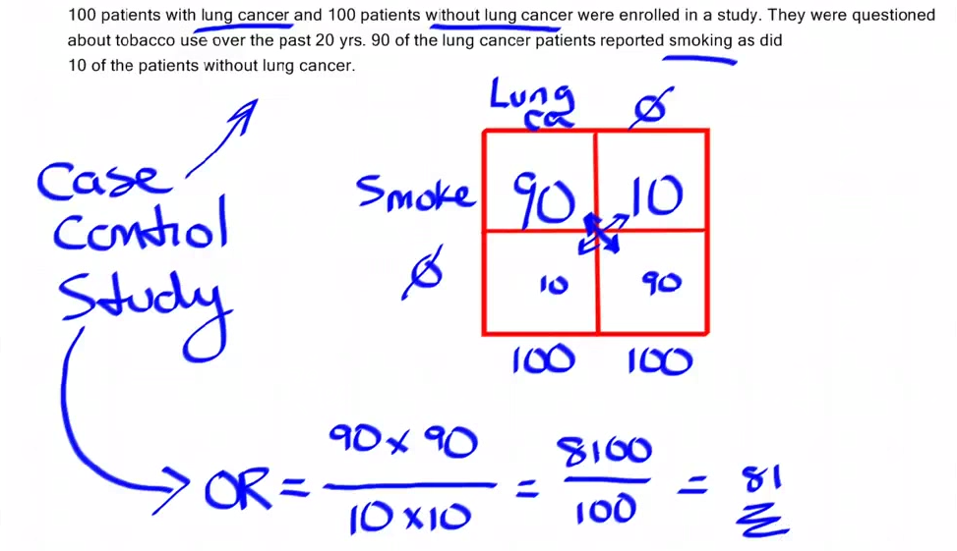
Odds Ratios
Notes:
In statistics, the odds ratio (usually abbreviated "OR") is one of three main ways to quantify how strongly the presence or absence of property A is associated with the presence or absence of property B in a given population.

Slide 44
Professional Effectiveness
Candidates who had employment were…
4.71x more likely
...than those who didn’t to find a job.

Slide 45
Professional Effectiveness
Candidates who had an internship were…
2.75x more likely
...than those who didn’t to find a job.

Slide 46
Professional Development
Candidates who attended conferences were…
3.33x more likely
...than those who didn’t to find a job.

Slide 47
Professional Development
Candidates who did workshops/seminars were…
2.05x more likely
...than those who didn’t to find a job.

Slide 48
Scholarship
Candidates who did had publications were…
2.75x more likely
...than those who didn’t to find a job.
Notes:
Doesn’t really fit, but

Slide 49
Service
Candidates who did committee work were…
3x more likely
...than those who didn’t to find a job.
Notes:
For every one person that did not do committee work that did find a job there are three that did do committee work and did find a job.

Slide 50
Job Search
Candidates who applied 4-6 months early were…
6.78x more likely
...than those who didn’t to find a job.
Notes:
Doesn’t really fit, but

Slide 51

Job Search
Candidates who applied 4-6 months early were…
6.78x more likely
...than those who didn’t to find a job.
Notes:
Doesn’t really fit, but

Slide 52

One Last Thing…
Successful Candidates
Unsuccessful Candidates
=

Slide 53
Conclusion
Notes:
ADVICE!!! END WITH ADVICE for SEARCH COMMITTEES from PAPER!!!

Slide 54

Notes:
So, one of the things we really liked about this, is that, you know, as a student, people are very eager to give you advice.
It’s true that as a student, you really want it, but people definitely like to give it.
You get it from professionals, your classmates, your professors, your advisors, your parents, event the Internet.
But the problem with a lot of this advice is that it’s anecdotal.
Problem with anecdotal is that sometimes it’s true and sometimes its not.

Slide 55
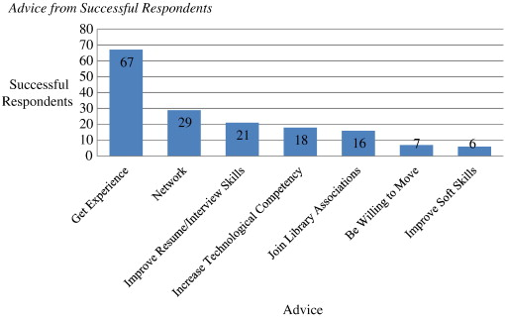
Notes:
To illustrate this point, I thought I’d show this figure from out paper.
It’s a visualization of a question we asked on advice people had for upcoming graduates.
It was a free text response, we coded it, and this is what we came up with.
It turns out that even the advice from successful respondents, who you think would know what they were talking about, doesn’t quite line up. (People knew to get experience, but you’d think that things like improve resume/interview skills, library associations, soft skills would be higher, and that some of these others (tech skills, willing to move) might not be on there.

Slide 56
Things that Actually Don’t Matter
Program format (online or in-person)
Graduate date (winter or spring)
GPA
Enrollment status (full-time or part-time)
Study abroad experience
Independent study
Tech skills
Notes:
Perhaps they are some misconceptions you’ve heard, I know they are some I’ve heard.
Program format (online or in-person)
Graduation date (winter or spring)
GPA (turns out everyone has a 4.0)
Enrollment status (full time or part time)
Study abroad experience (definitely good for other reasons…)
Independent study
Tech skills ← probably some issues with how we asked this question, but still

Slide 57
Notes:
If we take another looks at all this advice:
What we really liked, and what we thought we could contribute to this conversation…

Slide 58

OBJECTIVE
Notes:
…is that our study was objective, and that it quantified what is often just “anecdotal” advice.

Slide 59
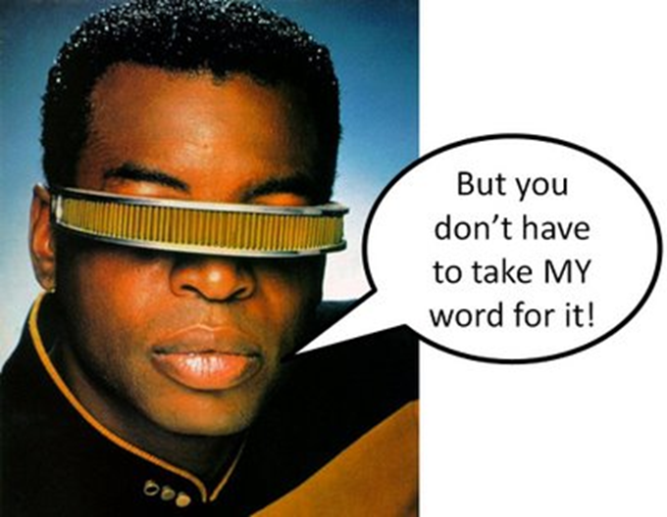
Notes:
So, real quick, I guess we just wanted to say that you don’t have to take our word for it…

Slide 60
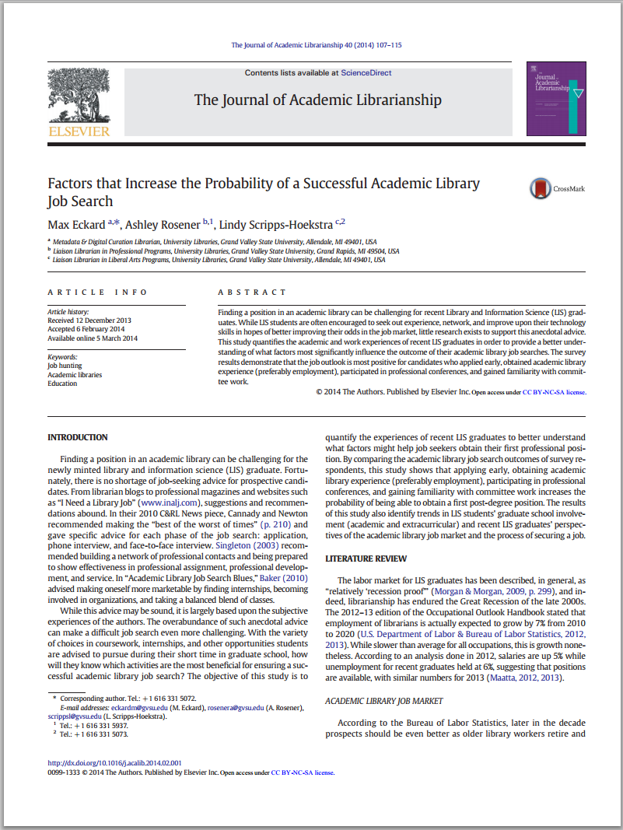
Notes:
…it’s totally OA and we also have a copy in GVSU’s institutional repository.
And I thought I’d conclude with our last paragraph:
For recent LIS graduates hoping to obtain academic library positions, the outlook appears positive for candidates who begin applying for jobs four to six months before graduation, and who are able to procure academic library experience (preferably employment), become involved with professional conferences, and gain familiarity with committee work. While these conclusions may not surprise many in the field, this study represents a quantitative understanding of oft-given job seeking advice. The advice given by 40% of successful respondents to get experience was sound…

Slide 61
Conclusion
“Experience makes all the difference!”
Notes:
…as one respondent stated, “Experience makes all the difference!”

Slide 62
Questions?

